Slide 1
Setting Up Pre-School Classrooms
Samuel De La Paz, Nate Edenfield,
Chris Oueis, Rahul Tejannavar

Slide 2
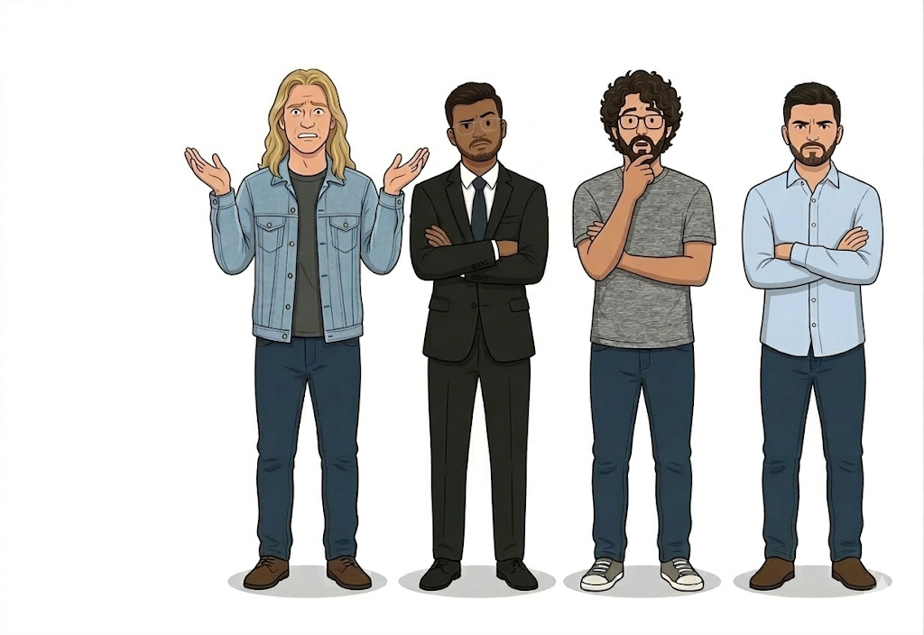
We need some help!

Slide 3


Certifications:
ESL
Certifications:
ESL
Certifications:
Special Ed
Certifications:
Special Ed
Certifications:
ESL
Special Ed
Certifications:
Special Ed

Slide 4
Room #1
Room #2
Room #3
Certifications:
ESL
Certifications:
Special Ed
Room #4
Room #5
Certifications:
Special Ed
Certifications:
ESL
Special Ed

Slide 5
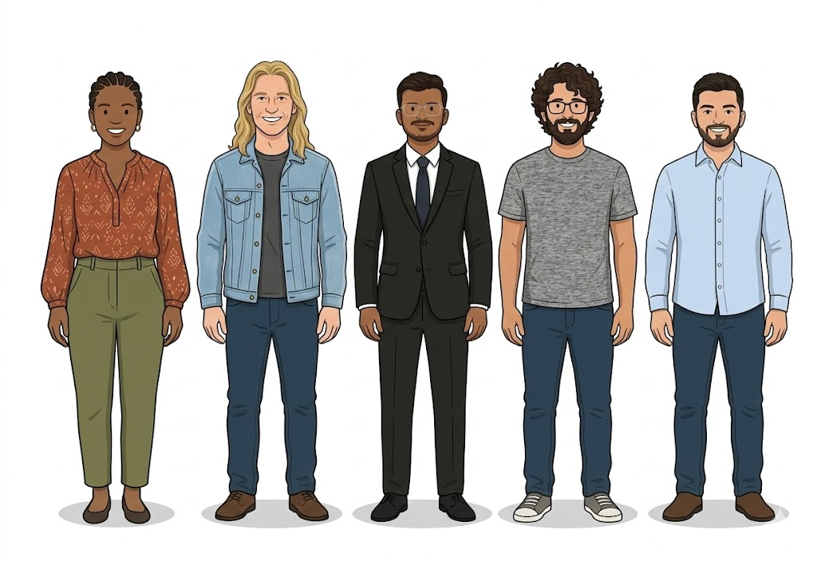
Paraprofessionals?

Slide 6

Backups Characters

Slide 7
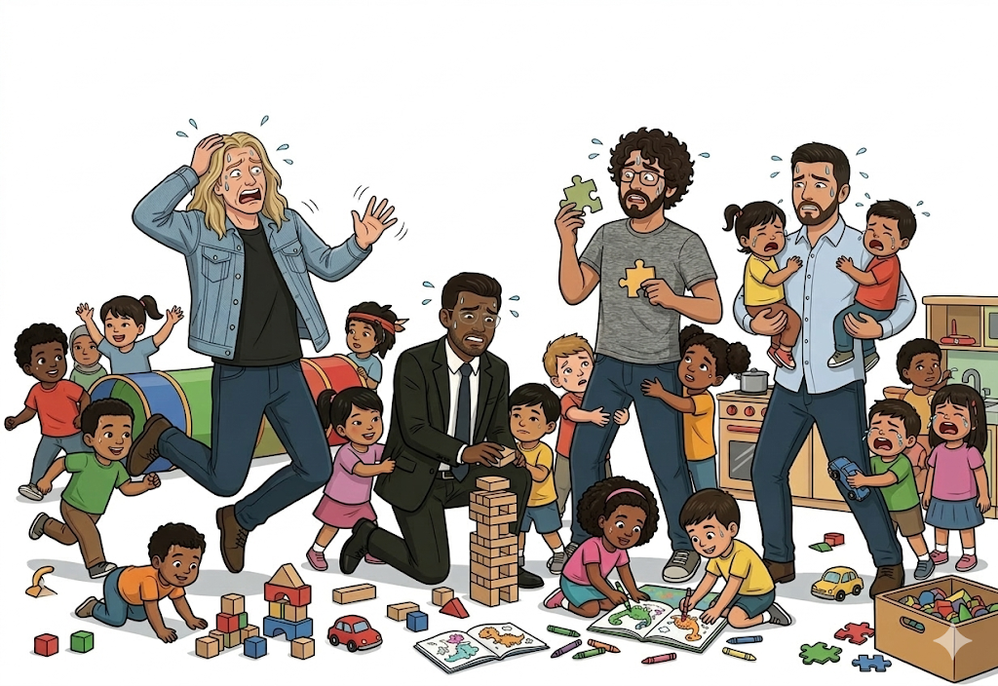

Slide 8
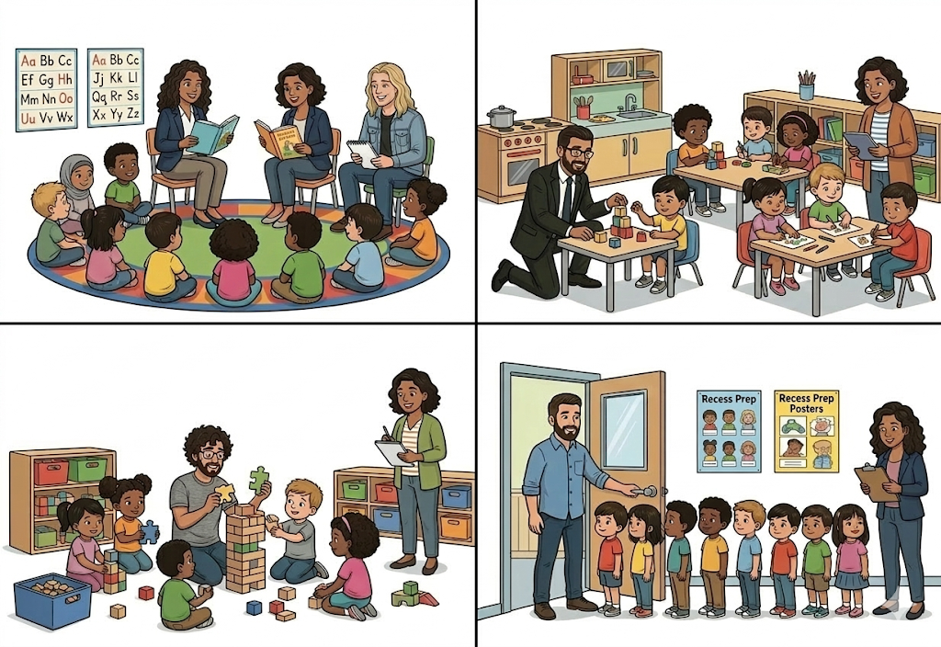

Slide 9

We did it, Hooray!

Slide 10
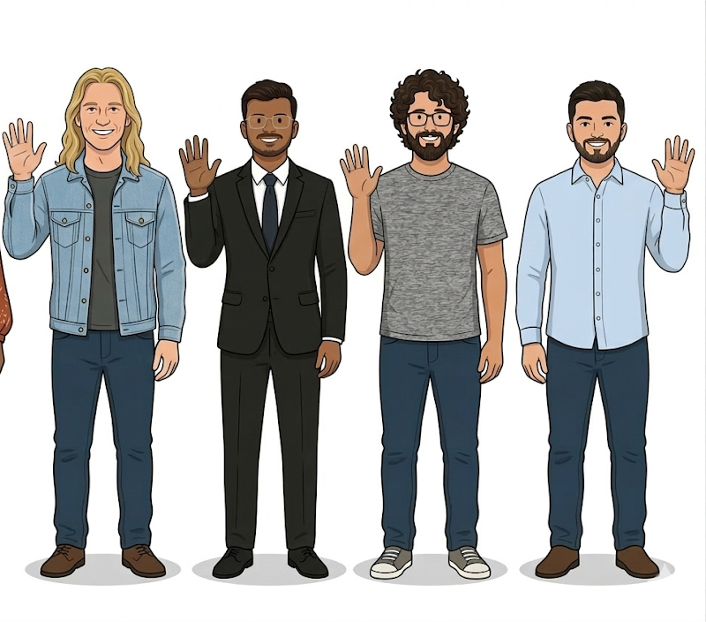
Thank you!

